Slide 1
Gamma Entrainment as a Biomarker in PD
Analyzing DBS-induced gamma oscillations across patient populations
Andrew Chan 7/24/2025

Slide 2
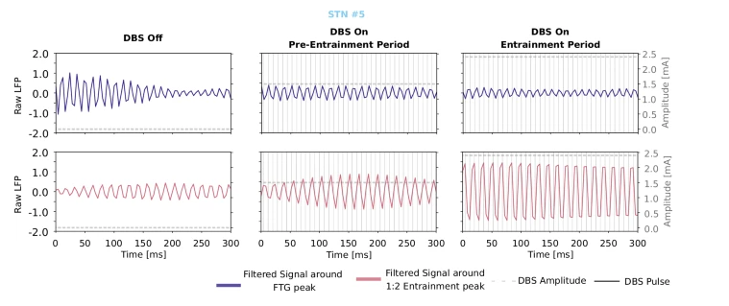
Background – What is Gamma Entrainment?
Definition: Synchronization of brain oscillations (60-90 Hz) to external stimulation
In PD context: DBS can entrain cortical gamma to subharmonic frequencies (1:2 ratio)
Clinical significance: It is a potential biomarker for therapeutic efficacy
Key Question: Can we reliably detect and utilize this phenomenon clinically?
Notes:
This diagram shows three different conditions. DBS off, Pre entrainment, and entrainment. DBS was applied at 125 Hz. The top row (purple) is the signal filtered at 76Hz and the bottom row (pink) is the signal filtered at 63 Hz. The left column is when the DBS is off. The purple trace shows a 76 Hz gamma oscillation but it fades out quickly while the pink trace shows minimal activity a 63 Hz. The key point is that there is no entrainment. The gamma is present but not synchronized to any stimulation. The middle column is when the DBS is on but pre entrainment. The DBS is on at 1.5 mA but not strong enough to produce entrainment. The purple trace still shows some activity near 76 Hz and the pink trace starts to show rhythmic 63 Hz activity, but is not clearly locked. The key point is that the system is being stimulated but the gamma rhythm is not yet entrained. In the right column, the DBS is on at 2.5 mA causing 1:2 entrainment, 63 is about half of 125. The clear peak of activity occurs every two DBS pulses as you can see from the dashed line, and this shows evidence of entrainment. The brains gamma oscillations are now phase locked to the external DBS.

Slide 3
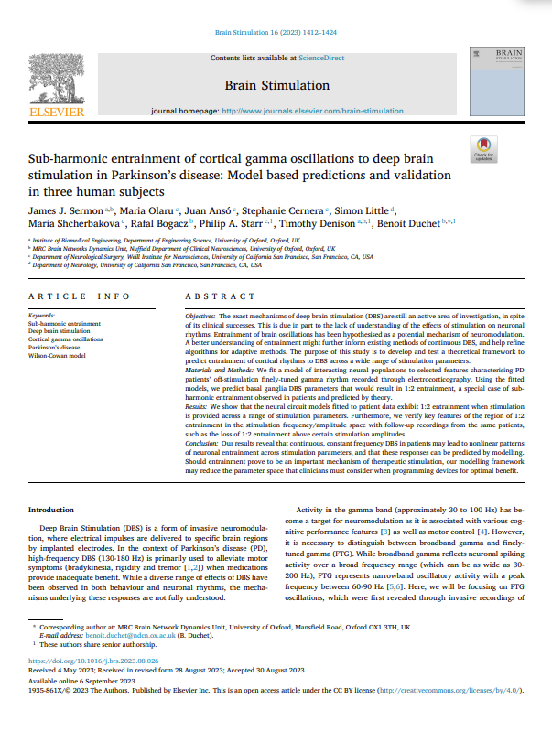
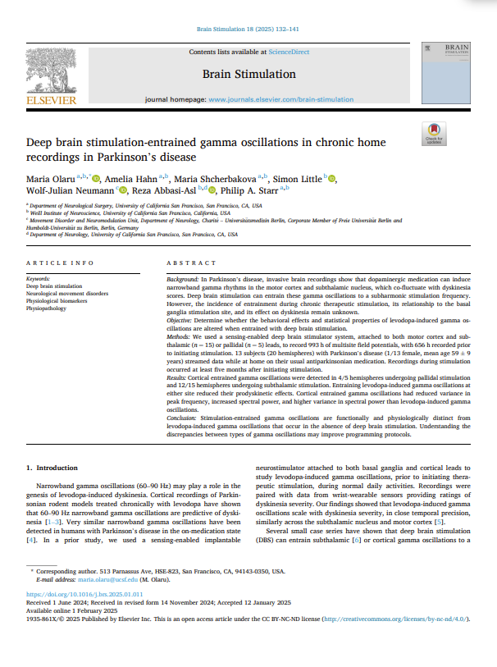
Literature Foundation – Nature Medicine Studies Overview
Sermon et al. (2023): Computational modeling and validation of entrainment mechanisms
Olaru et al. (2025): Chronic home recordings demonstrating entrainment prevalence
Combined Impact: Established both theoretical framework and real-world evidence
Notes:
I am sure you all are pretty familiar with these two papers but I thought I would just quickly recap what they talked about. The first one, written by Sermon, talks about how they developed and validated a computational model which can predict when DBS will produce sub harmonic 1:2 entrainment of cortical gamma rhythms. The second one, written by Oluaru in 2025 focuses on how DBS entrains gamma oscillations in PD patients during long term home recordings using Medtronics system. Combined, they establish both the real world clinical relevance and theoretical basis for using sub harmonic gamma entrainment as a biomarker and therapeutic mechanism in PD patients with DBS systems.

Slide 4
Study 2 – Olaru et al. (2025) Key Findings
Chronic Home Recordings in 13 PD Patients
993 hours of multisite field potential recordings
Cortical sensors: motor cortex and pallidal/subthalamic leads
4/6 patients used cortical sensors
Cortical entrainment detected in:
4/5 hemispheres with pallidal DBS
12/15 hemispheres with subthalamic DBS
Key findings: When gamma oscillations in the brain were entrained by DBS, they became less likely to cause dyskinesia, the involuntary movements often triggered by levodopa.
Clinical Relevance: Suggests that there is a therapeutic mechanism from natural gamma
Notes:
The more interesting paper which is related to my research was the second paper, written by Olaru in 2025. They amassed 993 hours of recordings with cortical sensors, sensing at the motor cortex with pallidal and subthalamic leads. 4 of the 6 patients used cortical sensors which is important and will be addressed in the following slide. cortical entrainment detected in 4/5 hemispheres for patients with pallidal DBS, and 12/15 hemispheres for patients with subthalamic DBS. The key finding was that when the gamma oscillations in the brain were entrained by DBS, they became less likely to cause dyskinesia which is the involuntary movements often triggered by medication like levodopa. This is relevant because it shows signs that there may be a beneficial effect (a therapeutic mechanism) that comes from the brain's own naturally occurring gamma oscillations.

Slide 5
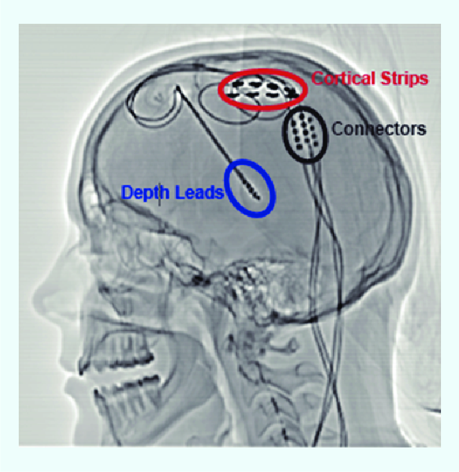
Cortical Sensing – Viability and Limitations
Advantages
Direct measurement of cortical response to subcortical stimulation
Higher signal-to-noise ratio for gamma detection
Limitations
Requires additional surgical implantation
Not a standard clinical practice
Limited to research settings
More artifact and harder to distinguish true entrainment compared to standard DBS data
Notes:
Cortical sensing mainly focuses on detecting and interpreting the electrical activity of the brain’s surface via electrodes placed on the surface of the brain, specifically the cerebral cortex. You can see in the image what cortical sensing can look like. Some of the advantages include direct measurement of cortical response to subcortical stimulation and higher signal-to-noise ratio for gamma detection. However, some limitations arise. It requires additional surgical implantation, isn’t a standard clinical practice, limited to research settings, and generally has more artifact and is harder to distinguish true entrainment compared to standard DBS data.

Slide 6
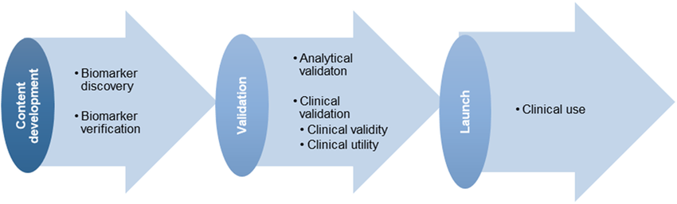
Current Project Overview
Expanding the Evidence Base
RQ: How prevalent is gamma entrainment in broader DBS patient population?
Dataset: Dr. Hammer’s patients + colleagues’ patients
Goal: Determine if gamma entrainment can serve as a clinical biomarker
Notes:
A quick overview of the project I have been working on. The main question I am working on is how prevalent is gamma entrainment in broader DBS patient population. The data I am using comes from Dr. Hammer and her colleagues patient data. The end goal is to determine if gamma entrainment can serve as a clinical biomarker

Slide 7
Dataset and Code
Patient Population Analysis
Total patients screened: 163 patients
Usable data: 22 patients (13.5%)
Primary limitations: Sensing was not activated during many of the clinical visits
Data types available: Streaming data, event recordings, clinical visit data
File processing: Batch analysis of JSON BrainSense files
Signal extraction: TimeDomain and LFP data processing
Spectrum analysis: Welch’s method for PSD
Entrainment detection: Peak detection at subharmonic frequencies
Output: Automated plots and statistical summaries
Notes:
This is a brief overview of the available data as well as a simple overview of how the code works. All in all, there were 163 patients worth of data, but only 22 of them had usable data. This is due to the fact that sensing was not activated during many of the clinical visits meaning a large portion of the data that I need is missing.

Slide 8
Data
Name | Target (STN or GPi) | Left (yes/no) | Condition (Channel Name and Frequency) | Right (yes/no) | Condition (Channel Name and Frequency)
Ba | STN | no |  | yes | ONE_THREE_RIGHT @ 125, ZERO_TWO_RIGHT @ 125
Bri | STN | yes | ONE_THREE_LEFT @ 125, ZERO_TWO_LEFT @ 125 | no
Bro | STN | no |  | no
De | Gpi | yes | ONE_THREE_LEFT @ 125 | no
Di | GPi | yes | ZERO_TWO_LEFT @ 145 | no
E | GPi | yes | ZERO_THREE_LEFT @ 145 | no
F | GPi | yes | ZERO_THREE_LEFT @ 125 | no
G | Vim | no |  | yes | ZERO_TWO_RIGHT @ 145
Haf | STN | no |  | no
Ham | STN | yes | ZERO_TWO_LEFT @ 125, ONE_THREE_RIGHT @ 145 | yes | ZERO_TWO_RIGHT @ 125, ZERO_TWO_LEFT @ 145
K | STN | yes | ONE_THREE_LEFT @ 180, ZERO_TWO_LEFT @ 180 | yes | ONE_THREE_RIGHT @ 145, ZERO_TWO_RIGHT @ 145, ZERO_TWO_RIGHT @ 180
M | GPi | no |  | yes | ONE_THREE_RIGHT @ 145, ZERO_TWO_RIGHT @ 125
N | STN | no |  | no
Ro | Gpi | no |  | no
Ru | STN | yes | ZERO_TWO_LEFT @ 180 | yes | ONE_THREE_RIGHT @ 180, ZERO_TWO_RIGHT @ 145, ZERO_TWO_RIGHT @ 180
Si | STN | no |  | no
St | STN | yes | ONE_THREE_LEFT @ 180, ZERO_TWO_LEFT @ 145 | yes | ONE_THREE_RIGHT @ 145, ONE_THREE_RIGHT @ 180, ZERO_THREE_RIGHT @ 145, ZERO_TWO_RIGHT @ 125, ZERO_TWO_RIGHT @ 145
T | GPi | no |  | no
Web | STN | yes | ZERO_TWO_LEFT @ 145 | no
Wei | STN | yes | ZERO_THREE_LEFT @ 165 | no
Wi | GPi | no |  | no
Wo | STON | no |  | yes | ONE_THREE_RIGHT @ 125, ZERO_THREE_RIGHT @ 125, ZERO_TWO_RIGHT @ 125
Notes:
Here you can see the 22 patients which had usable data. Their full last names have been redacted and just changed to the first couple of identifiable letters which we can reference later. The target column shows STN or Gpi. Left yes or no shows if the left hemisphere showed signs of gamma entrainment and if yes, then the channel name and frequency was marked down. Same for the right side.

Slide 9
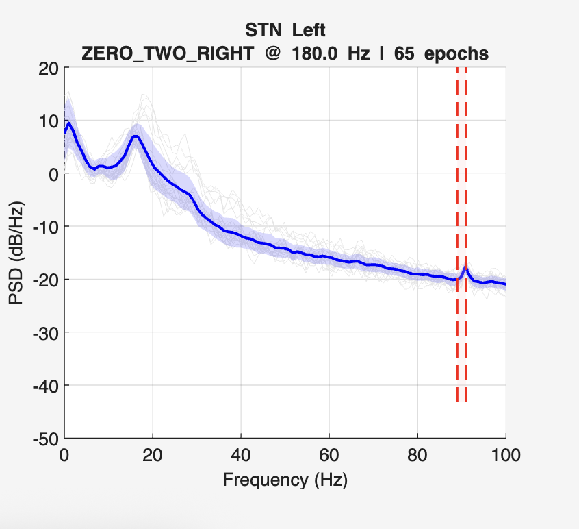
Representative Results – Strong Entrainment Example
Notes:
This is a patient Ru, and is a perfect example of strong entrainment. The stimulation was delivered at 180 Hz with entrainment showing up just at 90 Hz, clearly showing 1:2 entrainment. The peak exceeds the surrounding spectral power, indicating that the neural response is phase locked at a subharmonic of the stimulation.

Slide 10
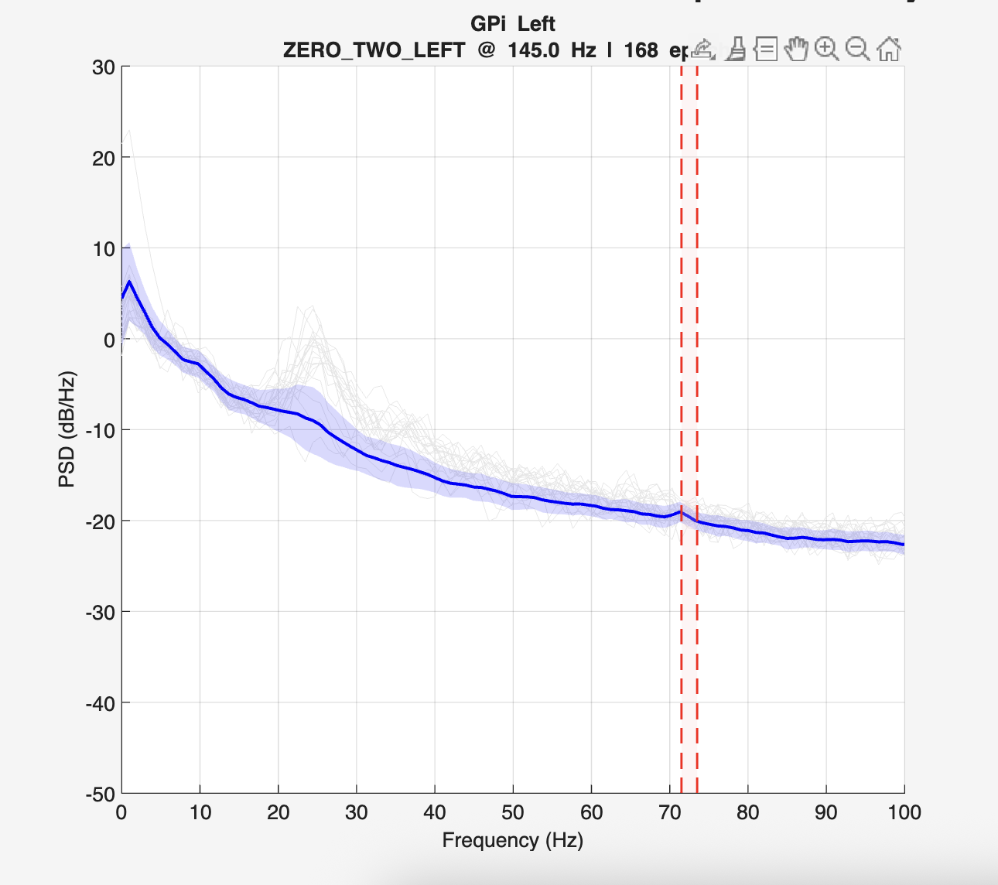
Representative Results – Weak Entrainment Example
Notes:
This is another patient Di, who is showing weak entrainment. This patient’s stimulation is being delivered at 145 Hz, and where we are expecting a peak at around 72.5 Hz, there is a small blip. Although the increase in spectral power is less pronounced than the previous strong entrainment example, we see a small bump in the PSD curve at the expected location. The mean trace (solid blue) shows a slight deviation upward at ~72.5 Hz, suggesting potential weak or borderline 1:2 entrainment.

Slide 11
Critical Limitation – Artifact vs. Entrainment
The Fundamental Challenge:
Subharmonic artifacts: Stimulation can create electrical artifacts at half-frequency
True neural entrainment: Physiological locking of neural oscillations
How to distinguish:
Temporal dynamics (entrainment should fluctuate with neural state)
Spatial patterns (should be anatomically specific
Medication effects (should correlate with clinical state)
Notes:
As you may know, when you stimulate the brain electrically, it can cause subharmonic artifacts. These are fake signals which show up in recordings because the electrical simulation itself, not the brain, is actually responding. For example, if I were to stim at 100Hz, I might see a peak at 50 Hz and that may not be a brain response and just be artifact. What we actually want is the measure the true neural entrainment which means the brain’s own natural oscillations are locking in sunc with the stimulation in the physiological way, showing that the brain is actually responding to the stimulation.
How can we tell the difference?
Temporal dynamics. True entrainment should change with the brain state such as sleep, attention, or medication. Artifacts will not vary in a meaningful or biologically relevant way.
2. Spatial patterns. Real neural entrainment should show up in specific brain regions which make sense anatomically (like the motor cortex for PD patients)
3. Medication effects: if entrainment disappears or changes with medication, that suggests its tied to the disease state, pointing to a real neural signal. Artifacts will not change with medication
What we can do to get data that we are more “sure” about is to look for state dependent modulation, matching symptom improvement worsening (I am working on using patient events to be able to filter out more of the data to refine and build upon this example. We can also compare on and off medication states, analyze across different recording co0ntacts, and assess onset/offset with stim changes

Slide 12
Colored Plot Analysis - Methodology
*Still a work in progress*
A Different Visualization Approach
X-axis: Stimulation amplitude (mA)
Y-axis: Entrainment power (normalized)
Color coding: Different recording dates
Purpose: Track entrainment stimulation relationships over time
Hypothesis: True entrainment should show temporal evolution, artifacts should remain static
Entrainment Power
Stim Amplitude (mA)
Notes:
The colored plot analysis is still a work in progress, but I plan to concatenate multiple visits worth of data into a graph, each visit represented by a different color. The X axis is a stim amplitude, and the Y axis is entrainment power.
What we’re hoping to see are a few key things that suggest real brain responses, not just noise:
- Dose response: Brain signal power goes up when stimulation is in the right range.
- Changes over time: The brain’s response might change week to week as the patient’s condition or treatment changes.
- Differences between people: Each patient might have their own “sweet spot” for stimulation.
Saturation: If you keep increasing the stimulation, the effect might stop growing or even go down.
In contrast, if what we’re seeing is just an artifact (fake signal from the device):
- The relationship will look flat and unchanging over time.
- It’ll show the same pattern every time, no matter the date or condition.
- It will scale in a simple, linear way with stimulation.
- And there will be no meaningful variation between patients or timepoints.

Slide 13
Next Steps
Generate colored plots for all 22 patients with usable data
Identify patients showing clear dose (amount of stim)-response relationships
Correlate temporal patterns with available clinical data
Distinguish true entrainment from artifactual signals
Success Criteria
Biological plausibility: Patterns consistent with neural adaptation
Clinical relevance: Correlation with therapeutic outcomes
Individual variability: Patient-specific optimal ranges
Temporal evolution: Evidence of physiological rather than purely electrical phenomena

